Slide 1
Coffee Roaster Project
Arduino & Android

Slide 2
Overview
Arduino
ESP32
Android
Android studio

Slide 3
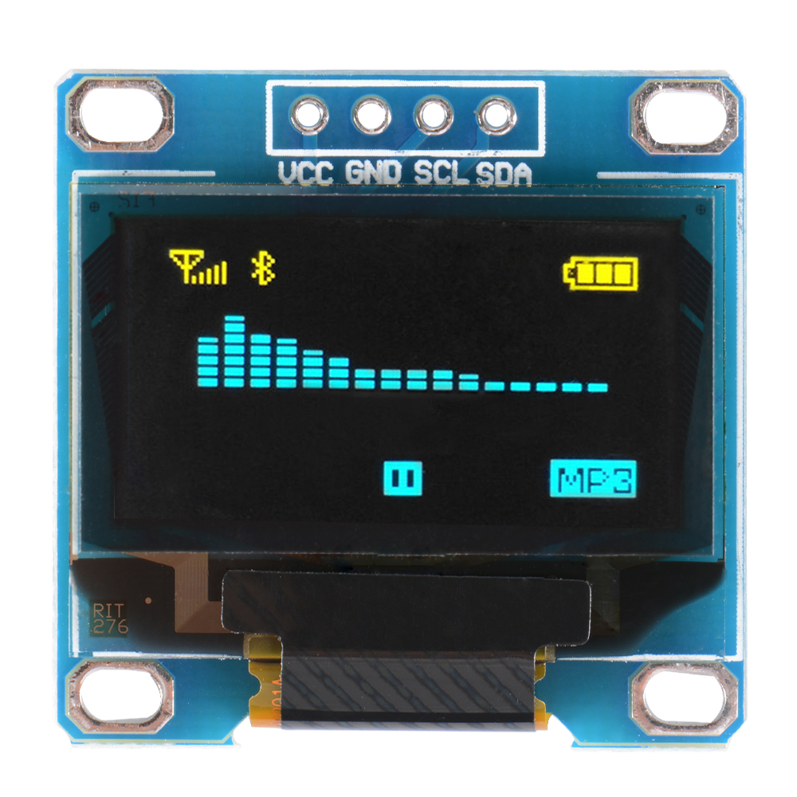
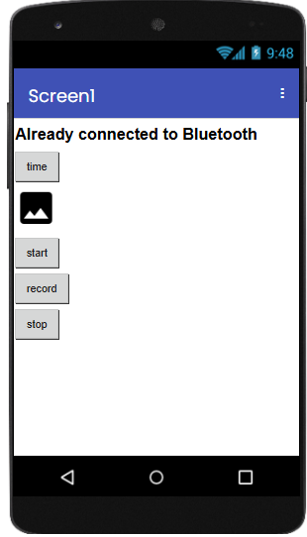

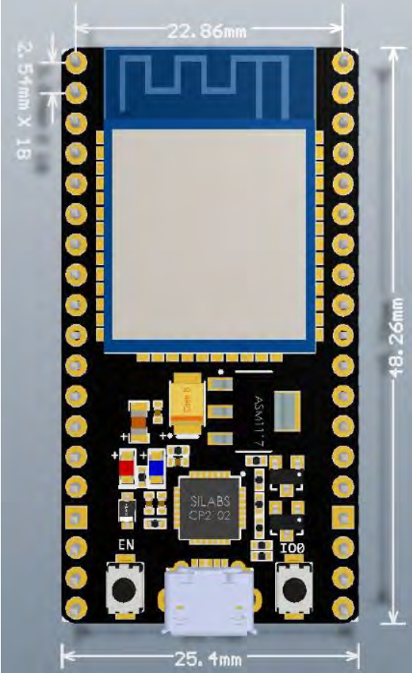
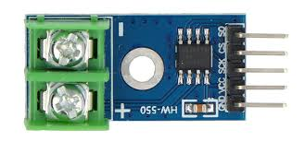
Layout
screen
MAX 6675
ESP32s
phone

Slide 4

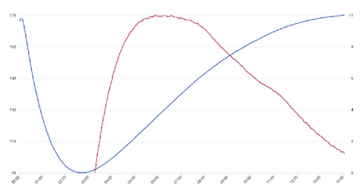

Flow
FileName
Folder
Find Bluetooh Device
Description
Save file
Bluetooth Adapter
Save file()
Bluetooth Socket
MSG: 23 °C
Input Stream
bluetoothSocket.getInputStream()
Geisha
saveFileActivity
updateLineChart()
start
record
stop
MAX 6675
ESP32s
Geisha
mainActivity
Description
Please get back to device !
blutoothOutOffRangeActivity
browseHistoryDataActivity

Slide 5
Goal
MAX 6675
Collecting temperature dynamically
ESP32s
Translate analogy signal change to digital
Via Bluetooth transmit data to phone
Android
Receive data from ESP32s
Show the curve visually
Start, Record temperature, End
Save file in local (.csv .jpg)

Slide 6
interface
Arduino & Android
Bluetooth interface

Slide 7
testcases
User out off Bluetooth range
Android: give caution closer to devices in case of losing data
Arduino: extra space to store the data when user out of range (SD card)
Need to deal with specific circumstance (還沒想到怎摩處理)

